Slide 1
DATA LAB - 3
Zhanna Kozlova

Slide 2
Today’s agenda
Kahoot’s on Scientific writing
Presentation of outlines
Discussion
Q&A

Slide 3
Please go to www.kahoot.com

Slide 4
Rule!!!
Use the same nick name during all the games

Slide 5
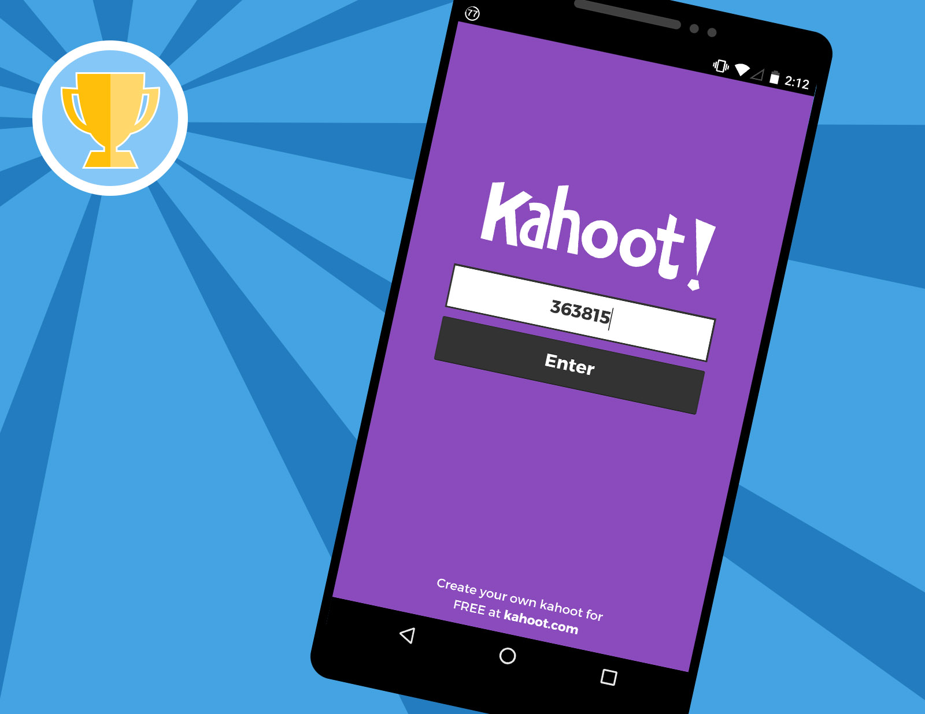

Slide 6
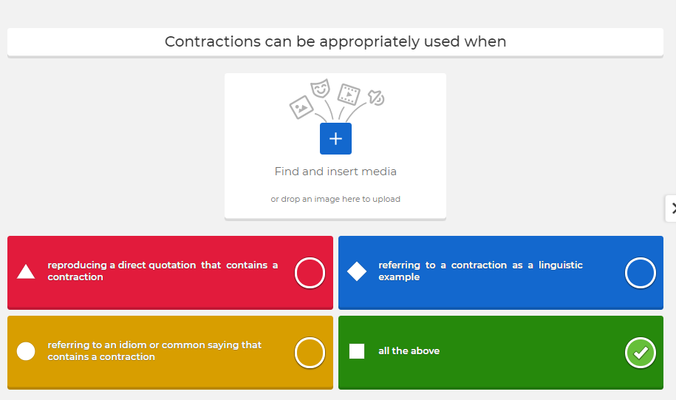
1.0. Rules of writing

Slide 7
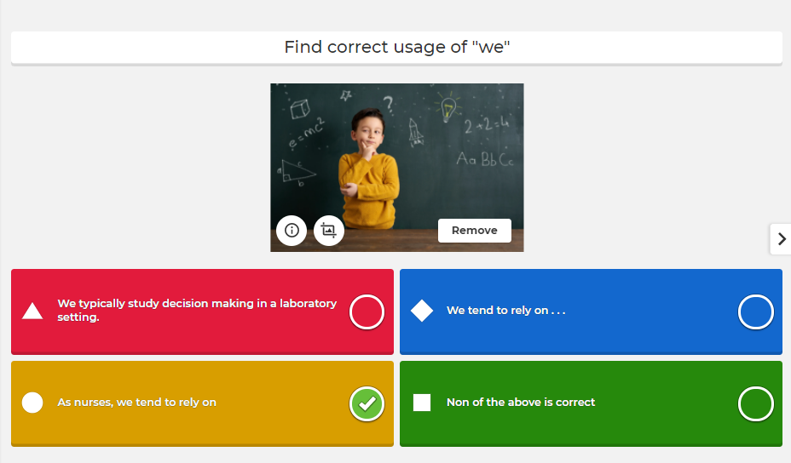
1.0. Rules of writing

Slide 8
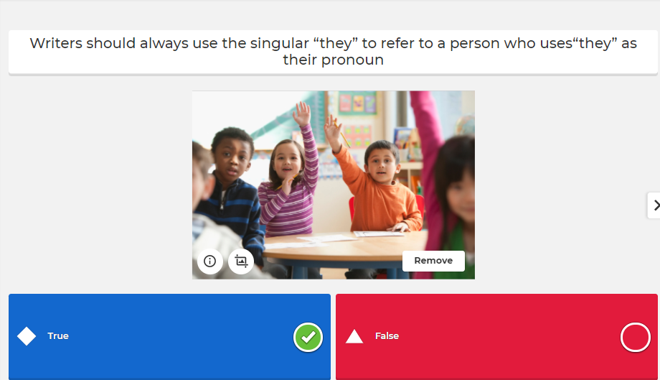
1.0. Rules of writing

Slide 9
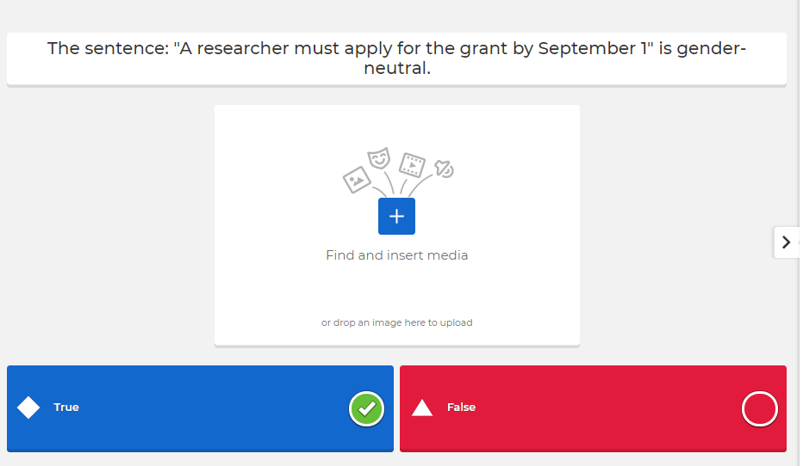
1.0. Rules of writing

Slide 10
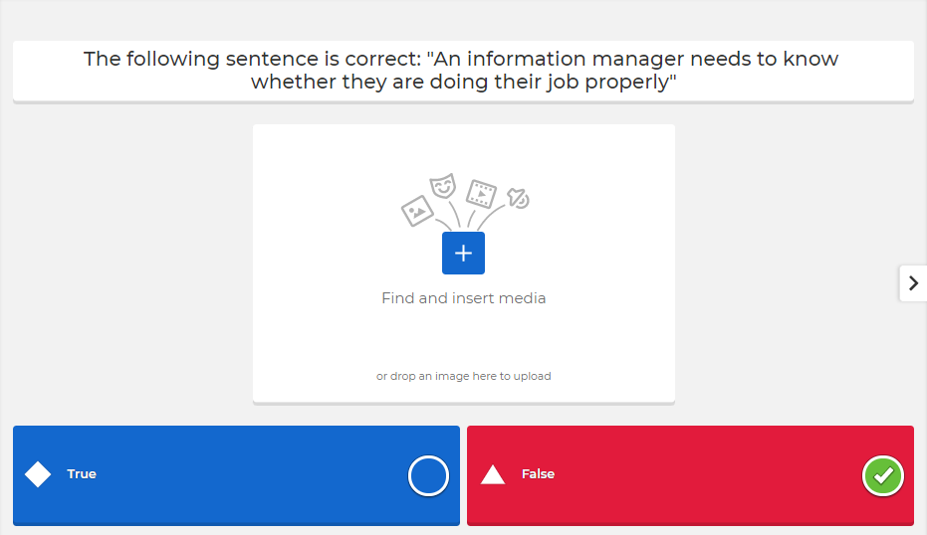
1.0. Rules of writing
Notes:
statement begins in the singular, but drifts into the plural. The following sentence is incorrect: An information manager needs to know whether they are doing their job properly. The easiest solution to this problem is to make both the subject and verb plura: lmanagers need to know whether they are doing their jobs properly.

Slide 11
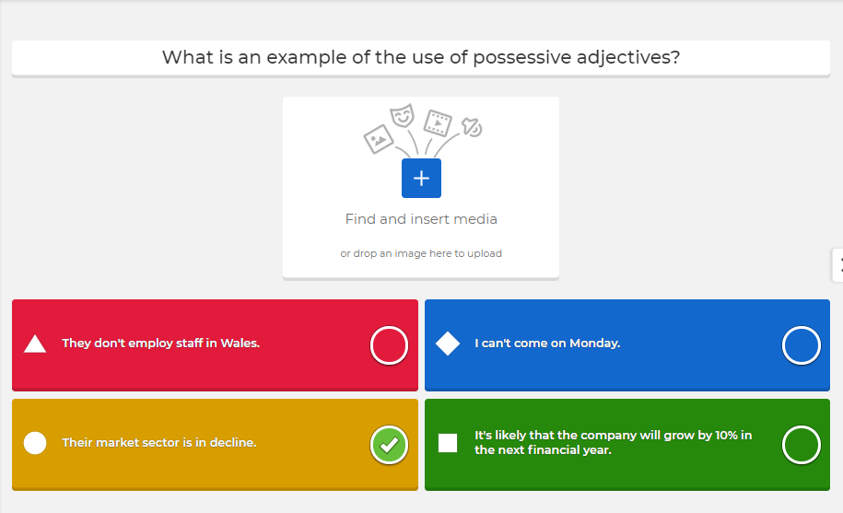
1.0. Rules of writing

Slide 12
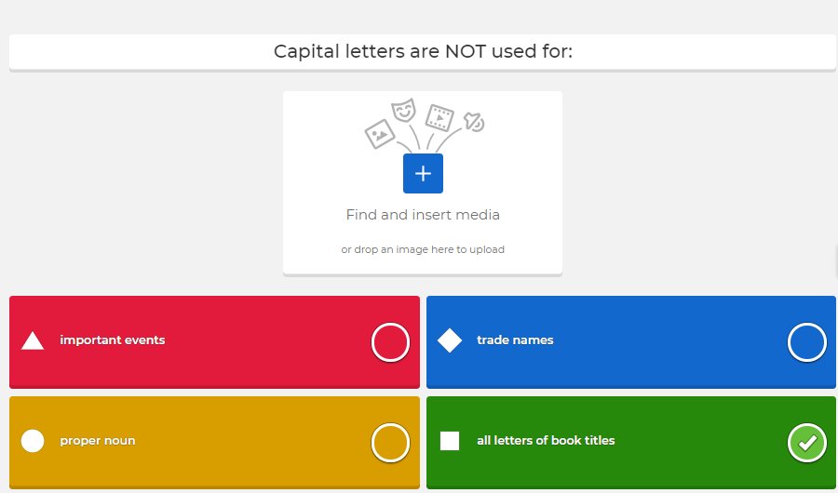
1.0. Rules of writing

Slide 13
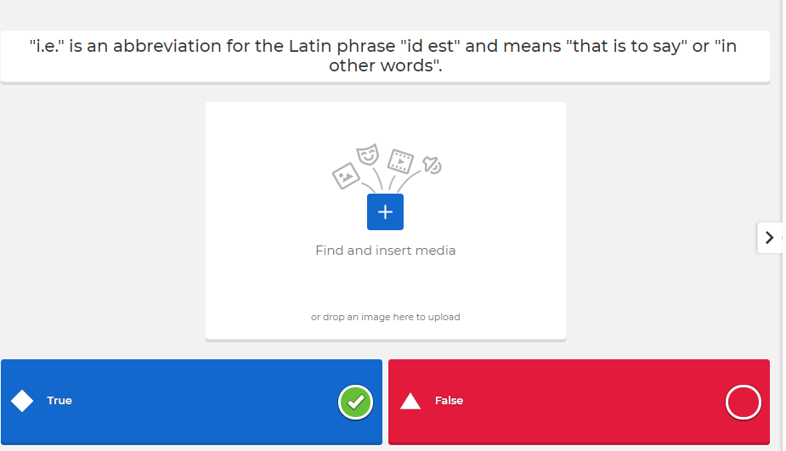
1.0. Rules of writing

Slide 14
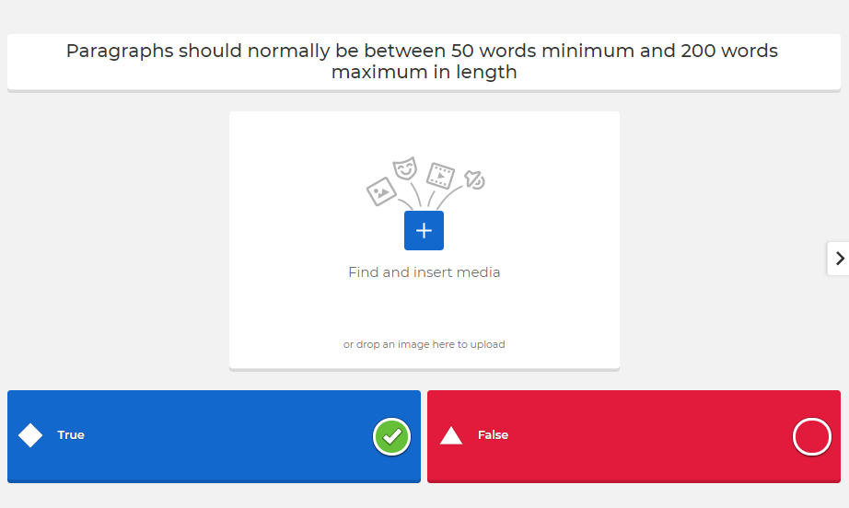
1.0. Rules of writing

Slide 15
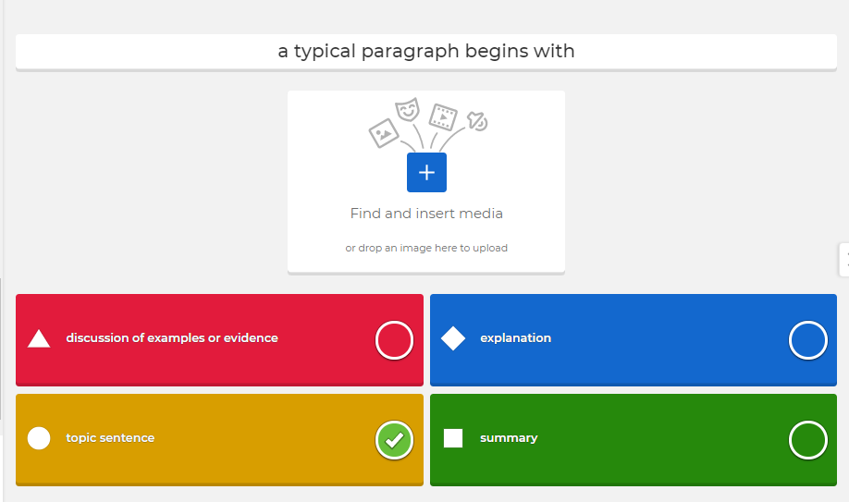
1.0. Rules of writing
Notes:
sentence should expand and develop the statement, explaining its significance to the question in general. This opening statement and amplification should then be followed by evidence to support the argument being made. You should provide illustrative examples which are discussed as an explanation of the central idea. Alternatively you can quote a source that supports your argument. The last sentence of a paragraph should round off the consideration of the topic in some way. It may also contain some statement which links it to the one which follows.
1. opening topic sentence, i.e. main point given 2. explanation of topic sentence 3. supporting sentences that explain its significance 4. discussion of examples or evidence (citing authorities; drawing on empirical evidence, i.e. research carried out by others or, in the case of a dissertation, you; drawing on your own experience, for example from placement) 5. concluding sentence

Slide 17
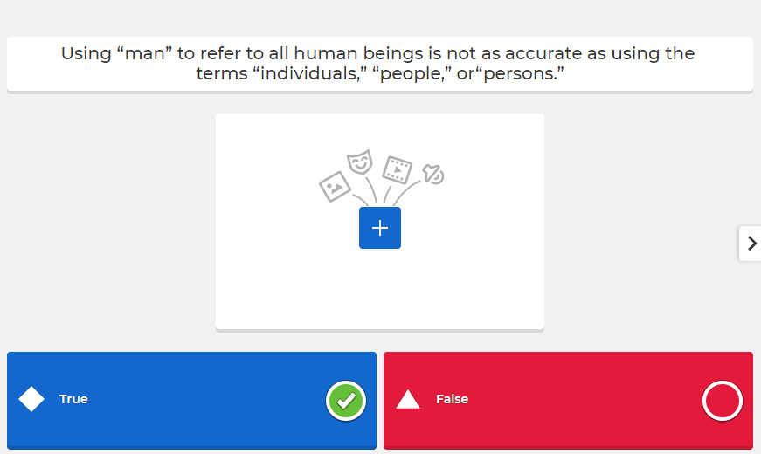
2.0. Bias-free language

Slide 18
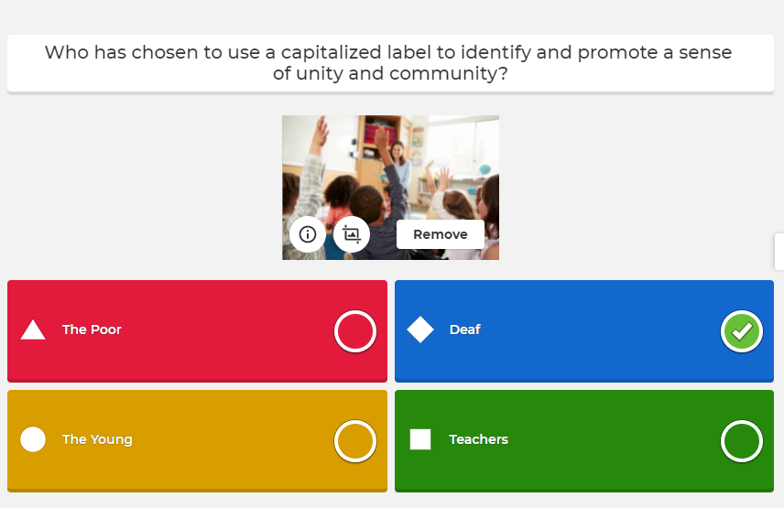
2.0. Bias-free language

Slide 19
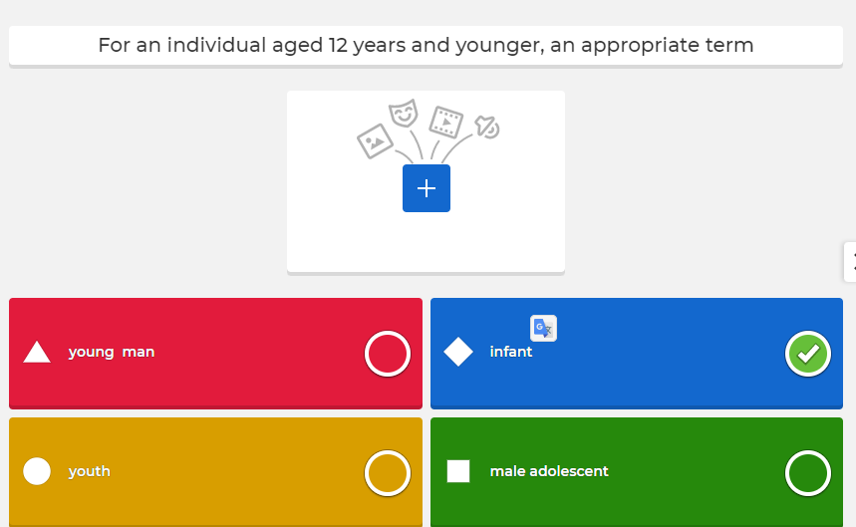
2.0. Bias-free language
Notes:
Young man – 13-17;youth, malde adolscent

Slide 20
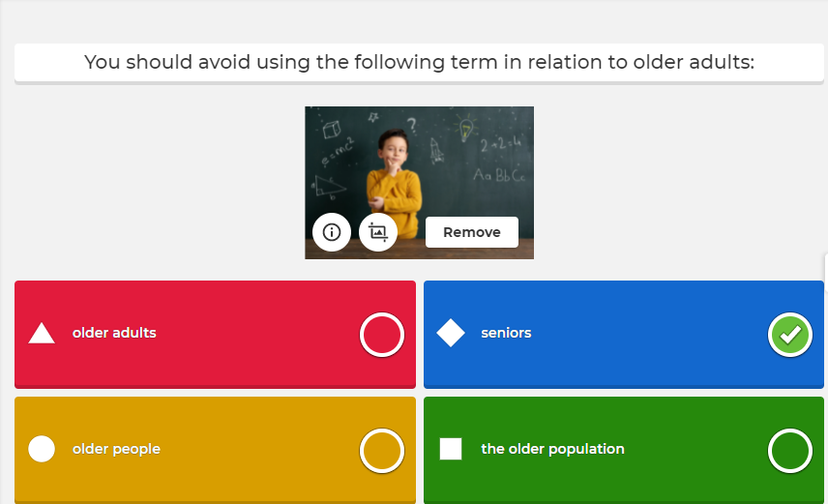
2.0. Bias-free language

Slide 21
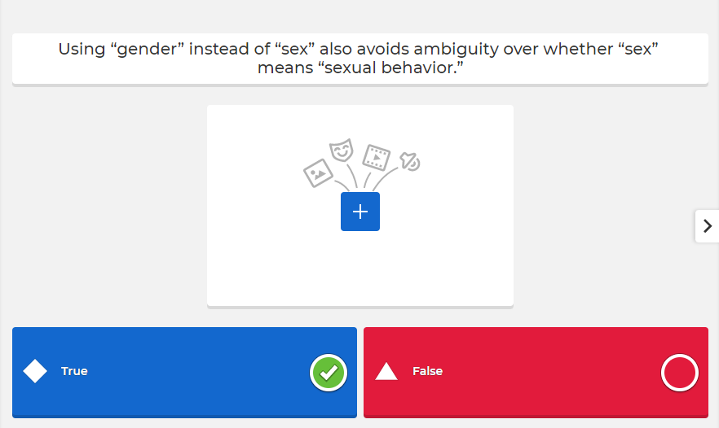
2.0. Bias-free language

Slide 22
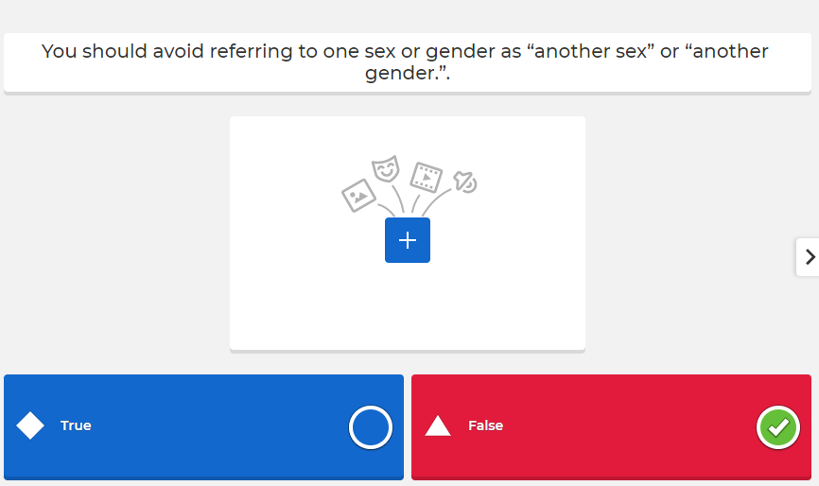
2.0. Bias-free language

Slide 23
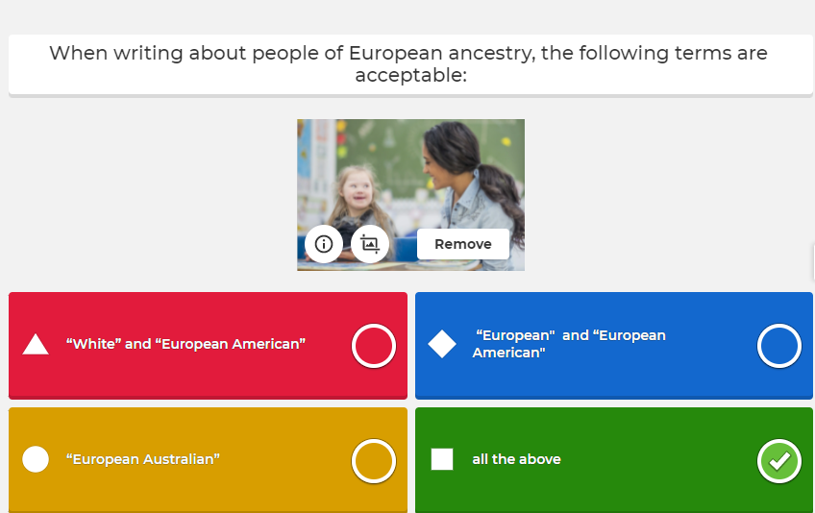
2.0. Bias-free language

Slide 24
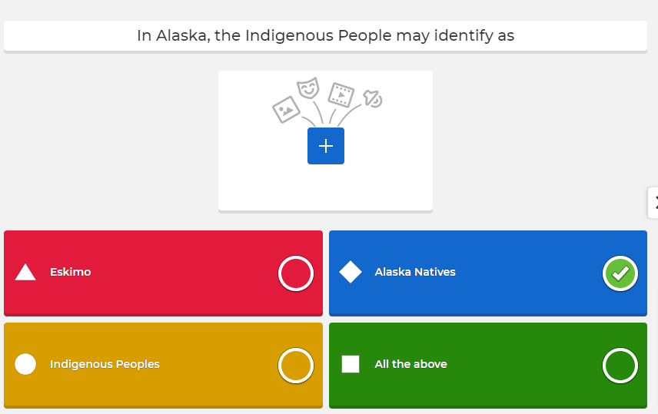
2.0. Bias-free language

Slide 25
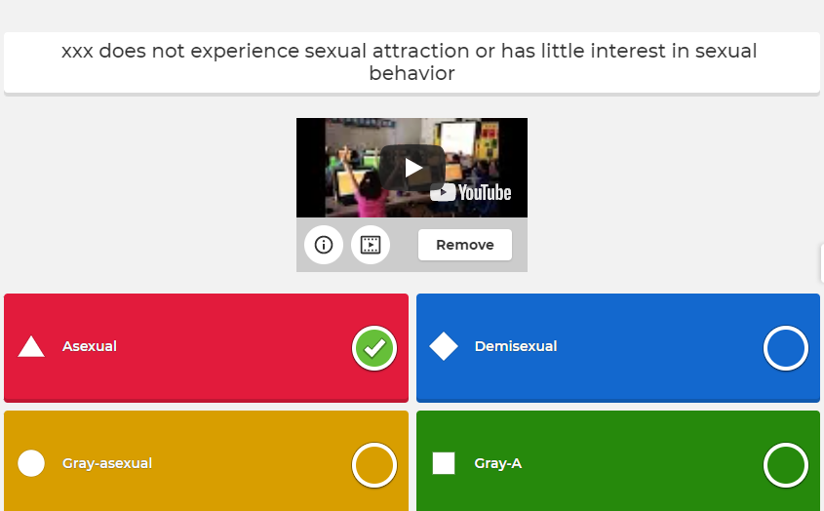
2.0. Bias-free language

Slide 26
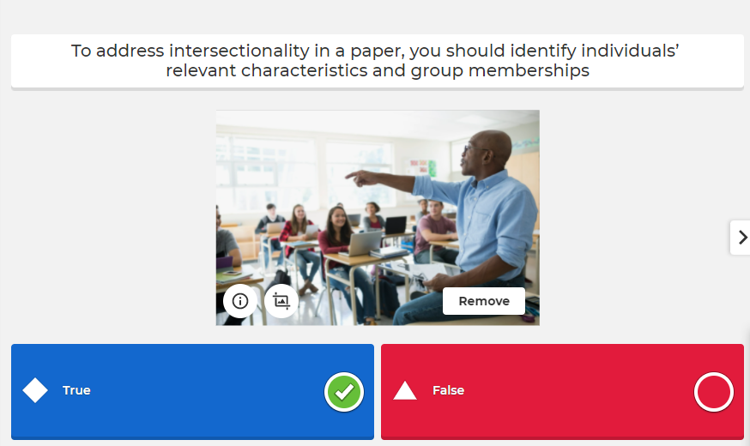
2.0. Bias-free language

